Slide 1

UPVIA
Transforming Raw Ideas into Applied Reality
THE SCIENCE OF IDEA VALIDATION
PRESENTED BY
Hamdy, Abdallah, Khaled, Ziad, Sherif, Nour, Abdelrahman, Omar S., Omar Y., Mostafa
Notes:
Welcome. We are UPVIA. In a world where 90% of startups fail, we don't just guess—we validate. We transform raw, unproven ideas into applied, market-ready reality through rigorous scientific methodology. We'll start by examining the pervasive problem that UPVIA addresses.

Slide 2

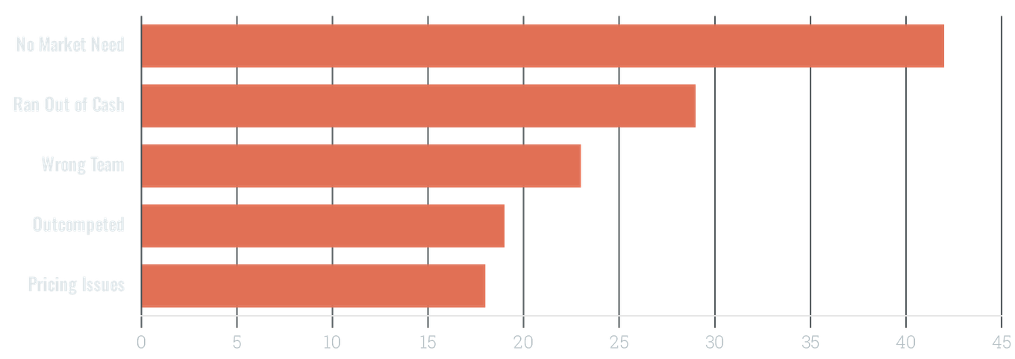
THE "IDEA DEATH VALLEY"
90%
TOP REASONS FOR FAILURE
OF STARTUPS FAIL
The gap between raw inspiration and market execution is where most ideas vanish. Lack of rigorous validation leads to building products that nobody wants.
SOURCE: CB INSIGHTS RESEARCH
Notes:
The world is full of ideas that die before they're born. Most fail because they lack validation. They solve problems that don't exist or use models that don't scale. This is the 'Idea Death Valley'—and UPVIA exists to bridge it. This problem demands a systematic, scientific approach, which we'll explore next.

Slide 3

THE UPVIA SOLUTION
A Rigorous, Objective Stress-Test for Business Ideas
T
R
I
THESIS CLARITY
SCIENTIFIC RIGOR
INTELLECTUAL HUMILITY
Every project begins with a clear hypothesis. We define the core value proposition and market assumptions with absolute precision, stripping away hype and ambiguity.
Integration of 10 proven scientific frameworks and a proprietary 32-POV stress test. We apply multi-lens analysis to ensure no blind spots remain.
Transparent acknowledgment of limitations. We identify what we don't know and where the data is thin, signaling credibility and research-driven integrity.
TRANSFORMING RAW IDEAS INTO APPLIED REALITY
Notes:
We built a system to save them. UPVIA isn't just a consulting firm; it's a laboratory for ideas. We apply 10 proven scientific frameworks and a proprietary 32-POV stress test to ensure every idea is grounded in reality before a single pound is spent. This rigorous validation is only possible with a diverse and capable team, which we'll introduce now.

Slide 4

10 MEMBERS, FUNCTIONAL ORGANIZATION
8 ORG MODELS
FUNCTIONAL TEAM STRUCTURE
FUNCTIONAL (CLASSIC)
SALES & INTAKE
RESEARCH
POD / SQUAD (SPOTIFY)
Sales Lead
Market Researcher
Intake Specialist
Data Analyst
PIPELINE (SEQUENTIAL)
MATRIX (DUAL-REPORTING)
TECHNOLOGY
FINANCE & OPS
CTO / Tech Lead
CFO / Finance
HOLACRATIC (ROLE-BASED)
MVP Builder
Operations Lead
RACI (RESPONSIBILITY)
AGILE (SCRUM)
STRATEGY
QUALITY & SUCCESS
Chief Strategist
QA Lead
FLAT (NO HIERARCHY)
Innovation Lead
Client Success
FUNCTIONAL STRUCTURE: CLEAR ACCOUNTABILITY, SPECIALIZED EXPERTISE, SCALABLE OPERATIONS
Notes:
This rigorous validation is only possible with a diverse and capable team, which we'll introduce now. We've structured our team using a classic functional model, emphasizing clear accountability and specialized expertise. This approach allows each of our ten members to focus deeply on their area, from sales and intake to quality and client success. We believe this functional structure provides the most robust foundation for our operations, ensuring every aspect of our validation process is handled by an expert. This multidisciplinary approach is critical for our unique 10-POV stress test.

Slide 5











THE 10-POV STRESS TEST
A Multi-Lens Analytical Engine to Eliminate Blind Spots
DEVIL'S ADVOCATE
CUSTOMER'S VOICE
COMPETITOR'S EYES
INVESTOR'S CALCULATION
REGULATOR'S GAVEL
Adversarial thinking: Why will this idea fail? Identifying the single most likely cause of death.
Demand-side reality: Does anyone actually want this badly enough to pay for it?
Competitive intelligence: Mapping direct, indirect, and substitute behaviors.
Legal & Compliance: Navigating Egyptian laws and industry-specific regulations.
Financial viability: LTV, CAC, burn rate, and break-even point analysis.
TECHNOLOGIST'S AUDIT
OPERATIONAL REALIST
PSYCHOLOGIST'S LENS
SCALE ARCHITECT
HISTORIAN'S JUDGMENT
Technical feasibility: Can this be built with existing tech at a sustainable cost?
Execution complexity: Daily requirements, supply chain, and quality control.
Behavioral feasibility: Switching costs and habit replacement analysis.
Growth & Scalability: Identifying bottlenecks when moving from 10 to 10,000 users.
Temporal analysis: Macro trends, timing, and the Gartner Hype Cycle.
PROPRIETARY METHODOLOGY FOR RIGOROUS IDEA VALIDATION
Notes:
This is our proprietary 10-POV Stress Test. It's a multi-lens analytical engine designed to eliminate blind spots in any business idea. Each perspective, from the Devil's Advocate to the Historian's Judgment, provides a critical filter. This comprehensive analysis ensures that every facet of an idea is rigorously examined, leaving no stone unturned.

Slide 6

10 SCIENTIFIC APPROACHES
Our Analytical Engine: Integrating Academic Rigor with Industry Best Practices
LEAN STARTUP
DESIGN THINKING
SYSTEMS THINKING
FIRST PRINCIPLES
JOBS TO BE DONE
Build-Measure-Learn loops to test riskiest assumptions with MVPs.
Human-centered empathy and rapid prototyping for user needs.
Mapping reinforcing and balancing loops within the business ecosystem.
Deconstructing ideas to fundamental truths to rebuild without bias.
Identifying the functional and emotional "jobs" customers hire products for.
BLUE OCEAN
BUSINESS MODEL CANVAS
SWOT + PESTLE
THEORY OF CONSTRAINTS
SCENARIO PLANNING
Creating uncontested market space through value innovation.
Combined internal and external macro-environmental analysis.
Preparing for multiple plausible futures through 2x2 uncertainty matrices.
Mapping 9 building blocks to identify structural vulnerabilities.
Identifying and elevating the single biggest bottleneck in the system.
SYSTEMATIC INTEGRATION FOR UNBIASED VALIDATION
Notes:
Our analytical engine, these 10 scientific approaches, form the bedrock of our validation process. We don't just pick one; we integrate them systematically for a truly unbiased assessment. This isn't just a list of buzzwords; it's a carefully curated toolkit. We leverage Lean Startup for rapid iteration and Design Thinking for deep user empathy. And we combine First Principles thinking with Blue Ocean strategy to uncover truly novel opportunities. This rigorous integration ensures we stress-test every idea from multiple, critical perspectives. Now, let's see how we applied a similar rigorous approach to our own business model.

Slide 7

SCAMPER MIND MAP: INNOVATION APPLIED
S
SUBSTITUTE
C
COMBINE
A
ADAPT
Digital-first intake systems and structured analytical frameworks to replace manual, ad-hoc processes.
Combining Internal Rate of Return (IRR) analysis with recurring subscription models for stable growth.
Adapting the "Medical Second Opinion" model to business ideas, providing independent, rigorous validation.
R
REVERSE
UPVIA
M
MODIFY
Reversing report structure (Conclusion First) and leading with identified failures to build trust.
INNOVATION ARCHITECTURE
Magnifying depth with 32-POV expansion and modifying team structure into 3-person autonomous pods.
E
ELIMINATE
P
PUT TO ANOTHER USE
Eliminating free, undisciplined consultations; replaced by the high-value, paid "Quick Scan" entry point.
Repurposing internal frameworks into online courses and downloadable checklist products.
Notes:
We applied the SCAMPER framework to our own business model, ensuring our innovation is as robust as the ideas we validate. We substituted traditional, ad-hoc consulting with digital-first, structured frameworks. We adapted the 'Medical Second Opinion' model to provide independent, rigorous validation for business ideas. And we modified our team structure into autonomous pods, significantly boosting our capacity and depth. This self-application of our principles demonstrates our commitment to continuous improvement. This innovation architecture directly informs our tiered service offerings, which I'll discuss next.

Slide 8




SERVICE TIERS
Scalable Validation for Every Stage of the Entrepreneurial Journey
MOST POPULAR
QUICK SCAN
FULL ANALYSIS
LAUNCH-READY
ADVISORY
48 HOURS
2 WEEKS
4 WEEKS
MONTHLY
10 PAGES
50 PAGES
100 PAGES
ONGOING
5,000 EGP
25,000 EGP
75,000 EGP
5-15K EGP
The "Medical Second Opinion" for ideas. A rapid feasibility check using our core 10-POV engine to identify immediate red flags and potential.
A deep dive into market dynamics, competitor intelligence, and technical feasibility. Includes a comprehensive financial model with 3 scenarios.
The complete execution blueprint. Includes technical architecture, MVP prototyping, legal registration support, and a full go-to-market roadmap.
Continuous strategic support. We act as your external R&D and strategy department, providing ongoing validation as your business evolves.
Notes:
Our service tiers offer scalable validation, meeting entrepreneurs at every stage of their journey. From the 'Quick Scan,' a rapid 48-hour feasibility check, to the 'Launch-Ready' complete execution blueprint, we provide tailored solutions. The 'Medical Second Opinion' concept, which we adapted, underpins our Quick Scan, offering fast, critical feedback. And our Advisory tier provides continuous strategic support, acting as an external R&D department. These tiers ensure accessibility and relevance across the entrepreneurial spectrum. But how do these services position us strategically in the market?

Slide 9





STRATEGIC POSITION (SWOT)
STRENGTHS
WEAKNESSES
10-person multidisciplinary team covering tech, finance, and research.
Zero existing client base or documented track record in the market.
Proprietary 32-POV Stress Test methodology grounded in academic rigor.
Student status leads to limited professional industry experience.
Time constraints: University coursework competes with company operations.
Full-stack technical capability to build actual MVPs and prototypes.
OPPORTUNITIES
THREATS
Growing Egyptian startup ecosystem (TIEC, Flat6Labs, RiseUp).
Established players like Flat6Labs have brand and funding advantages.
Egypt Vision 2030 prioritizes entrepreneurship and SME development.
Free alternatives (ChatGPT, templates) reduce willingness to pay.
Underserved segment: Idea-stage entrepreneurs lack validation options.
Economic instability and EGP devaluation affecting startup spending.
Notes:
Our SWOT analysis provides a clear picture of our strategic position, highlighting both our advantages and the challenges we face. Our multidisciplinary team and proprietary 32-POV methodology are significant strengths, allowing us to offer unparalleled depth. We acknowledge our weaknesses, particularly our lack of a track record and time constraints due to our student status. However, the growing Egyptian startup ecosystem presents a massive opportunity, especially the underserved idea-stage segment. We are mindful of threats from established players and free AI tools, but our unique value proposition sets us apart. This realistic assessment informs our competitive strategy, which I'll detail next.

Slide 10
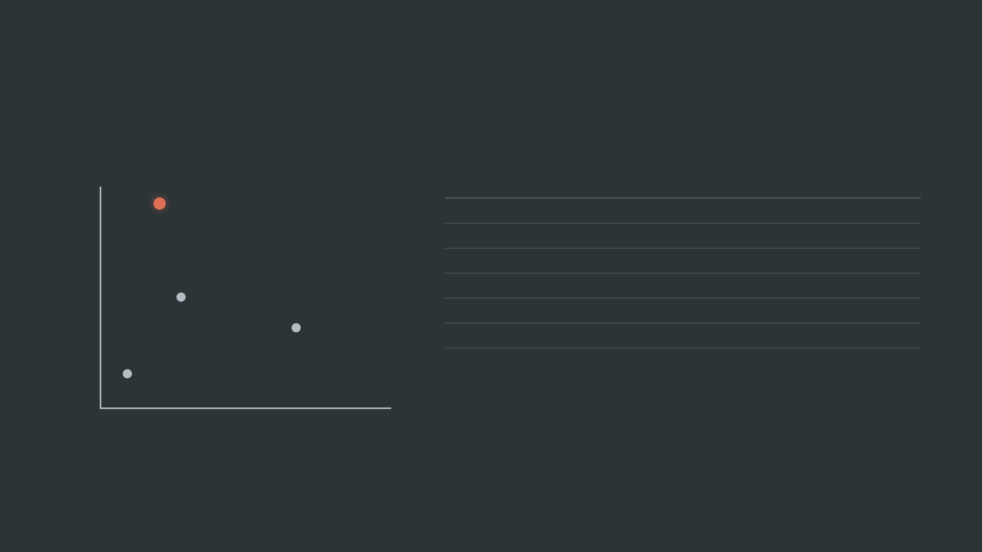
WHY UPVIA?
MARKET POSITIONING
THE COMPETITIVE EDGE
DEEP ANALYSIS
FEATURE
CHATGPT
ACCELERATORS
UPVIA
UPVIA
32-POV Methodology
Turnaround Time
Instant
Months
48h - 4wk
Equity Required
None
5-10%
Zero
Accelerators
Objectivity
High
Biased
Scientific Rigor
Low
Moderate
Freelancers
Technical MVP
ChatGPT
"Unlike accelerators, we have no equity stake. We are paid for the quality of our analysis, not the success of the idea. This makes our recommendations 100% unbiased."
SHALLOW
LOW PRICE
HIGH PRICE
UPVIA occupies the unique quadrant of Deep Analysis at a Competitive Price, enabled by our digital-first pod structure.
Notes:
We've established our strategic position, and now we clarify our competitive edge. UPVIA offers deep analysis at a competitive price, a unique quadrant enabled by our digital-first pod structure. Unlike accelerators, we take no equity, ensuring our recommendations are 100% unbiased. Our 32-POV methodology provides scientific rigor, delivering results in days or weeks, not months. This positions us distinctly against both shallow AI tools and equity-demanding accelerators. Next, we'll address what we don't yet know.

Slide 11




INTELLECTUAL HUMILITY
What We Don't Know Yet: A Transparent Assessment of Current Gaps
EMPIRICAL VALIDATION
PROJECTION RISKS
CAPACITY CONSTRAINTS
Our 10-POV methodology is theoretically grounded but lacks empirical validation through real-world client engagements. We are addressing this through three pro-bono pilot projects in our first month.
Financial projections are based on industry benchmarks, not actual revenue data. The conversion rate from Quick Scan to Full Analysis remains our most critical unknown variable.
As a student team, our capacity is limited to 150 person-hours per week. This requires rigorous project management and strict adherence to our pod-based delivery structure.
THINKING LIKE RESEARCHERS, NOT SALESPEOPLE
Notes:
While we're confident in our competitive edge, we approach this venture with intellectual humility. Our 10-POV methodology, though theoretically sound, requires empirical validation through real-world client engagements. Our financial projections, while robust, rely on estimated conversion rates, which remain a critical unknown. And as a student team, our capacity is finite, demanding rigorous project management. This transparency underscores our research-driven mindset. Now, we turn to you for a directed dialogue.

Slide 12


THREE QUESTIONS FOR YOUR EXPERTISE
1. Are there gaps in our 10-POV validation methodology that we have not yet identified?
2. Are our financial assumptions realistic for the current Egyptian market context?
3. Which scientific frameworks would you recommend we prioritize in our first three client engagements?
"WE ARE HERE TO LEARN, NOT TO CONVINCE."
UPVIA
contact@upvia.com
www.upvia.com
Notes:
Doctor, we value your expertise, and we're here to learn, not to convince. We've prepared three specific questions to guide our dialogue. First, do you identify any gaps in our 10-POV validation methodology? Second, are our financial assumptions realistic for the current Egyptian market? Finally, which scientific frameworks should we prioritize in our initial client engagements? We eagerly await your insights.

